Slide 1

Hotel Aggregator Analysis With Microsoft PowerBI
by Lancelot Uwagboe

Slide 2
CONTENT
Introduction
Description of Data Set
Project Objectives
Data Visualization
Findings
Recommendations
Conclusion

Slide 3

Introduction
This project aims to analyze a dataset of hotel aggregator listings using Power BI. The dataset comprises various attributes related to listings, host reviews, and availability.
The objective is to create comprehensive visualizations and insights that shed light on trends, patterns, and factors influencing the performance of listings.
Using Power BI, key metrics such as pricing, availability, host characteristics, and review scores have been used to derive actionable insights for improving the overall quality and competitiveness of the listings.

Slide 4
Description of Data Set
The data set consists of the rows below:
1. id: Unique identifier for each listing.
2. listing_url: URL of the listing on the hotel aggregator platform.
3. scrape_id: Identifier for the data scraping event.
4. last_scraped: Date of the last data scrape.
5. source: Source of the listing information.
6. name: Name of the listing.
7. description: Description of the listing.
8. neighborhood_overview: Overview of the neighborhood where the listing is located.
9. picture_url: URL of the listing's picture.
10. host_id: Unique identifier for the host.
11. ... (and many more columns capturing details about hosts, location, property type, room details,
amenities, pricing, availability, reviews, and other relevant information)

Slide 5

Project Objectives
1. Geographical Insights:
- Visualize the distribution of listings on a map to identify popular neighborhoods.
- Explore the geographical concentration of listings and host locations.
2. Pricing and Availability Analysis:
- Analyze pricing trends based on property types, room types, and accommodation capacity.
- Investigate the availability of listings over time and identify peak periods.
3. Host Performance:
- Evaluate host characteristics, including super host status, response times, and verification methods.
- Explore correlations between host attributes and listing performance.
4. Review Scores and Guest Satisfaction:
- Examine review scores and their impact on overall listing performance.
- Identify areas for improvement based on specific review categories.
5. Property Type and Room Analysis:
- Analyse the distribution of property types and room types.
- Explore trends in the popularity of specific accommodation setups.

Slide 6
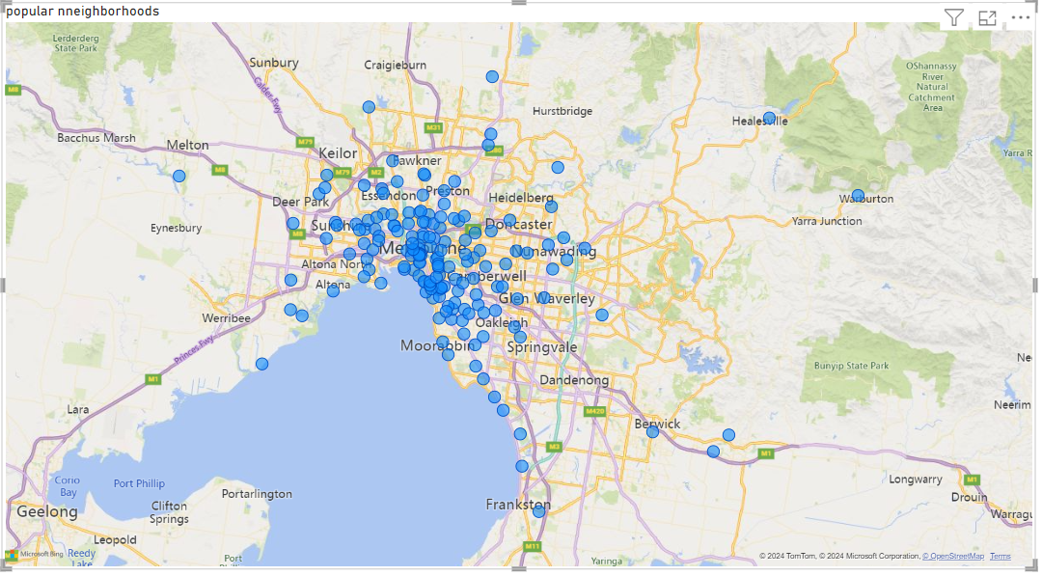
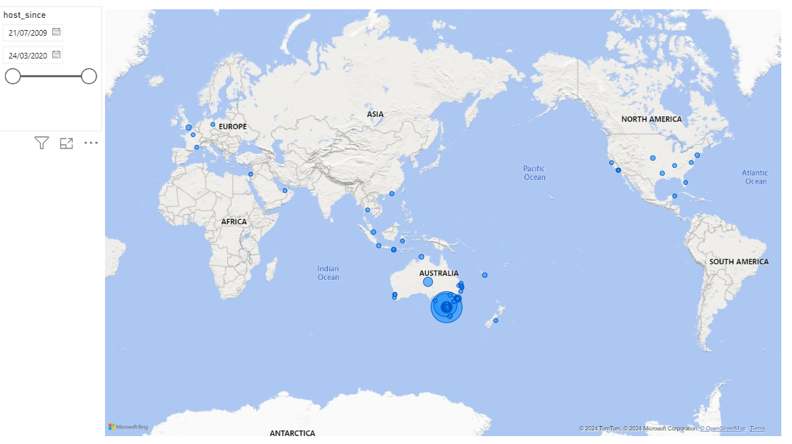
Geographical Insights
Map showing Geographical Distribution of Popular Locations and Listings

Slide 7
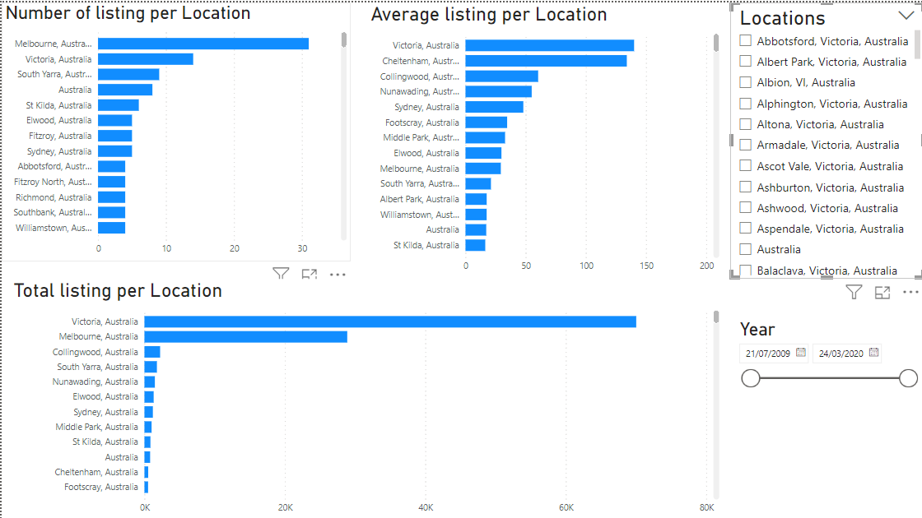
Geographical Insights Contd.

Slide 8
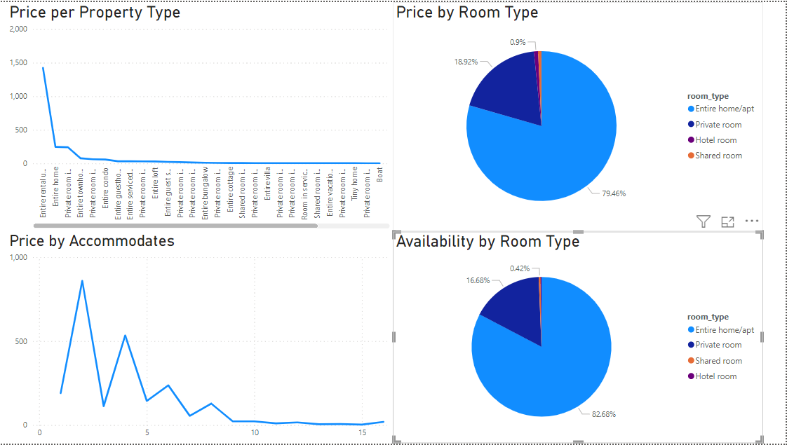
Pricing and Availability Insights

Slide 9
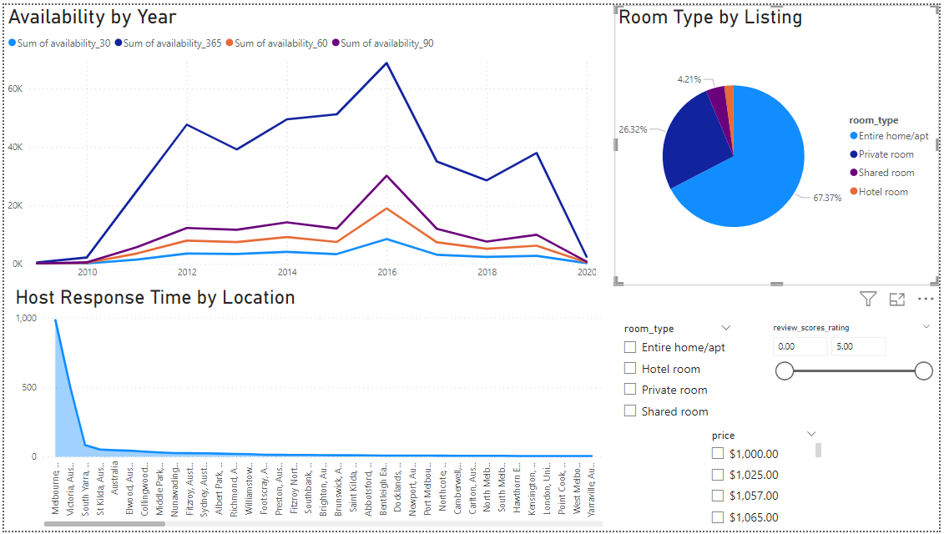
Pricing, Availability, and Host Characteristic Insights

Slide 10
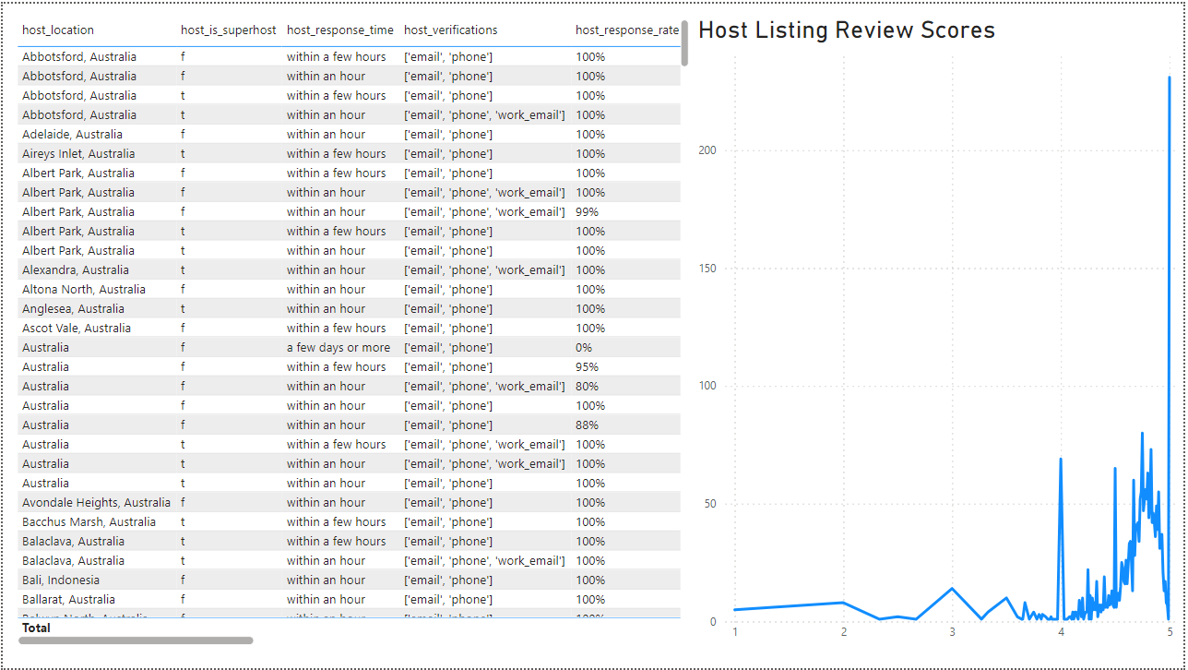
Host Characteristic and Performance Insights

Slide 11
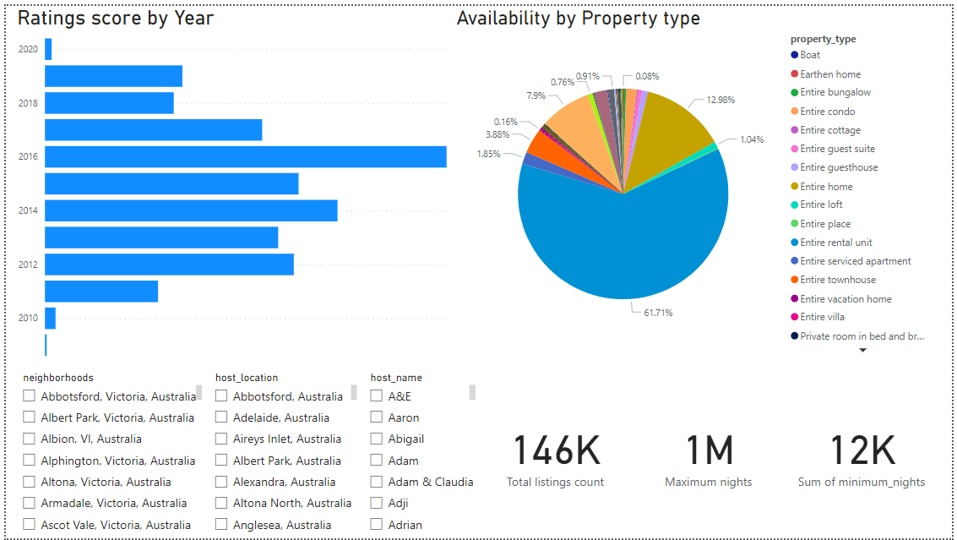
Property and Room Type Analysis

Slide 12
Findings
Geographical Insights:
Popular Neighbourhoods: Melbourne, Australia, leads with 31 listings, followed by Victoria at 14.
Host Concentration: The neighbourhood of St Kida/Prahan shows high concentrations of hosts.
Pricing and Availability Analysis:
Pricing Trends: Entire home/apartment listings have the highest price per property type.
Availability Patterns: The highest availability was observed in 2016.
Host Performance:
Superhost Impact: Listings do not attribute a significant influence to being a Superhost on listing performance.
Response Time and Verification: Positive correlations were found between prompt response times, verification methods, and higher performance ratings, often reaching 5 stars.
Review Scores and Guest Satisfaction:
Review Score Impact: Higher response and acceptance rates correlate with higher review scores, potentially up to 5 stars.
Areas for Improvement: Cleanliness received a lower rating, averaging 4.67.
Property Type and Room Analysis:
Property Distribution: The most prevalent property type is Entire Rental Units, followed by Entire Homes out of all listings.
Room Type Trends: The most popular room types are Entire homes/apartments with 67.37%, followed by Private rooms with 26.32%.
Accommodation Capacity: Listings accommodating 2 guests are the most popular.

Slide 13
Recommendations
Geographical Insights:
Explore opportunities to enhance listings in popular neighbourhoods like Melbourne and Port Phillip.
Consider strategic partnerships or marketing initiatives to further engage hosts in high-concentration areas like Newton/Enmore.
Pricing and Availability Analysis:
Optimize pricing strategies, especially for Casa Particular properties, to maximize revenue potential.
Monitor availability trends closely, particularly during peak periods like the observed high availability in 2016, to ensure optimal listing performance.
Host Performance:
Provide support and resources for hosts to improve response times and verification methods, as they positively impact performance ratings.
Encourage hosts to maintain high standards of cleanliness, given its significant impact on guest satisfaction.
Review Scores and Guest Satisfaction:
Offer training or guidance to hosts on maintaining high response and acceptance rates to boost review scores.
Implement initiatives to address cleanliness concerns and improve overall guest satisfaction.
Property Type and Room Analysis:
Consider promoting Entire Rental Units and Entire Homes as they dominate the market, while also highlighting the popularity of Private rooms.
Encourage hosts to cater to the demand for accommodations accommodating two guests, potentially through tailored marketing campaigns.

Slide 14
Conclusion In conclusion, analysis of the hotel aggregator dataset has provided valuable insights into various aspects of listings, host performance, and guest satisfaction. Key findings highlight opportunities for optimizing pricing strategies, enhancing host performance, and addressing guest preferences. By leveraging these insights and implementing targeted recommendations, we can strive to improve the overall quality and competitiveness of listings on the platform. Moving forward, continued monitoring and adaptation will be essential to staying responsive to market dynamics and maintaining a high level of service excellence.

Slide 15
Thank You

